Slide 1
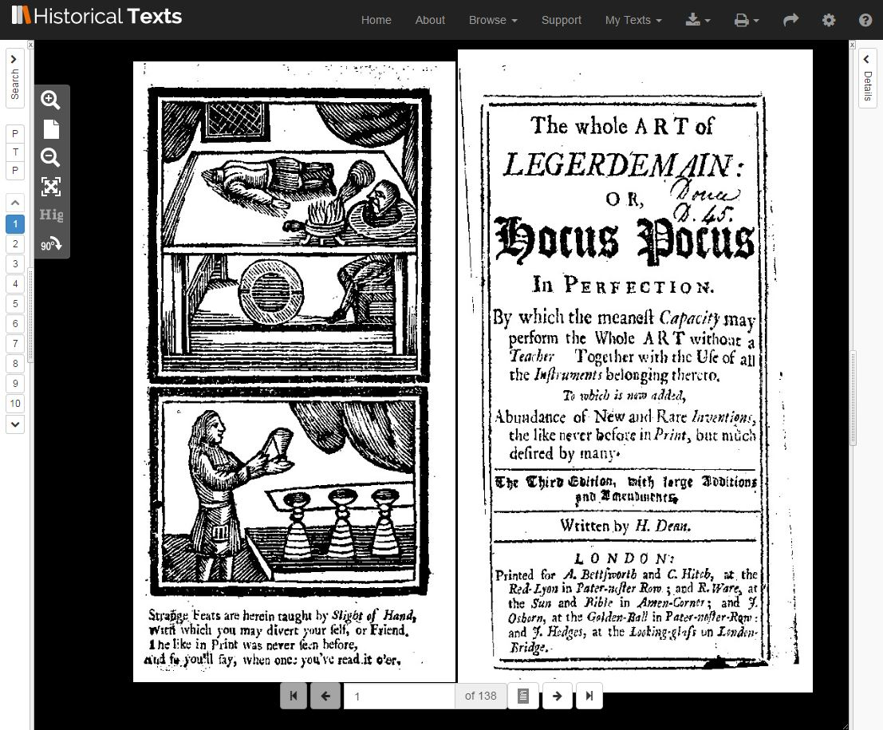
Historical Texts update (June 2017)
Background and content

Slide 2
Overview
What is Historical Texts?
Historical texts is a service that enables you to search, view and download 400,000 texts published from the late C15th to the long C19th
https://historicaltexts.jisc.ac.uk

Slide 3
Overview
What is Historical Texts?
It contains four collections:
Early English Books Online (EEBO) (1473-1700)
Eighteenth Century Collections Online (ECCO) (1701-1800)
British Library 19th Century collection (1789-1914)
UK Medical Heritage Library
Including a wealth of content and coverage of subject areas including English literature, history, geography, science, religion and medicine.

Slide 4
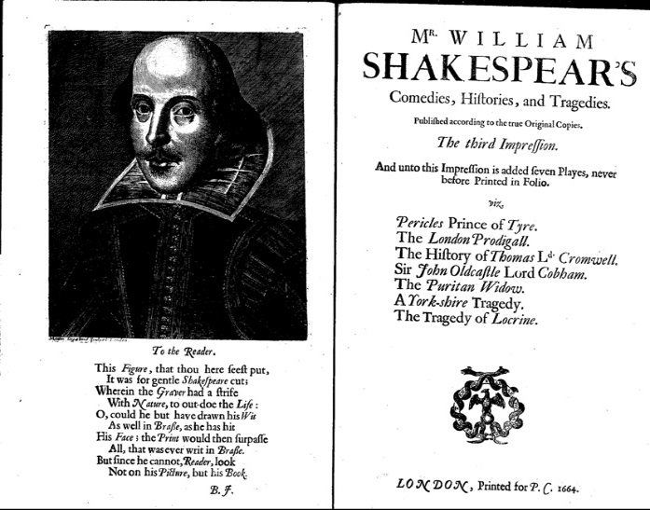
Content
Early English Books Online (EEBO)
From the first book printed in English by William Caxton, EEBO includes over 125,000 titles published in Britain and British North America, and works in English printed elsewhere, between 1473 and 1700 covering a wealth of early modern materials.
Notes:
All works included in the Historical Texts EEBO collection have page images (digital facsimiles). These pages have been digitised by opening (which often means there are two physical pages per image) from microfilms, which is why they are black and white. The scans were provided by ProQuest, who operate the commercial EEBO platform. Currently, for around 40% of this collection, there are also searchable plain text transcriptions. These are manually transcribed versions of the page images, produced by the Text Creation Partnership (TCP). The text transcriptions for individual works can be identified in Historical Texts on the results page by having a "full text" label underneath them.

Slide 5
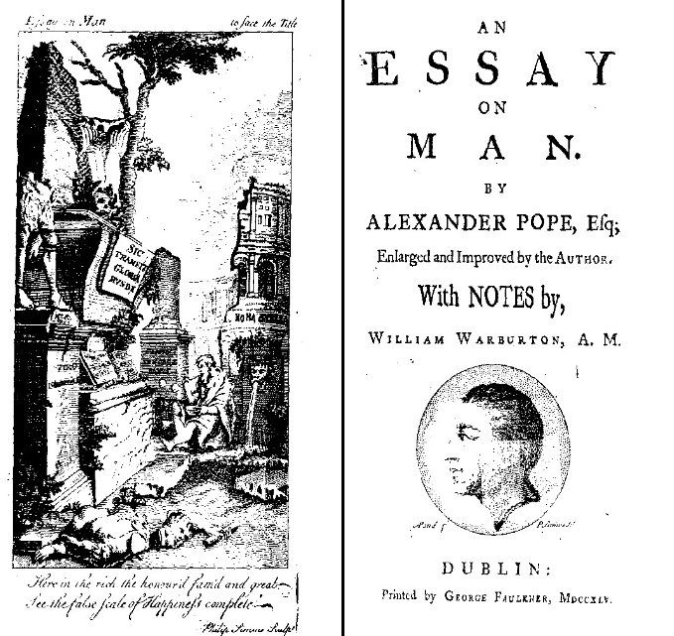
Content
Eighteenth Century Collections Online (ECCO)
A collection of all the books published in Great Britain and its colonies during the eighteenth century, comprising 33 million pages from more than 180,000 titles. The collection includes works in English, Dutch, French, German, Italian, Latin, Spanish and Welsh.
Notes:
ECCO is the largest collection in Historical Texts, comprising more than 200k titles.
Unlike EEBO, OCR has been applied to the EEBO collection. There are, as you know, numerous problems with OCR, but it does allow for greater access to the content than simply searching the metadata. In Historical Texts wherever OCR is available you have the option to view the text, worts and all. We believe it is important to give researchers access to the data that underpins their searches, and allow them to see the limitations of the data they are searching against. To counter this problem, The Text Creation Partnership has produced around 2000 manually keyed full text transcriptions for ECCO. These transcriptions were added to Historical Texts this year and replace the existing Optical Character Recognition (OCR) full text for these records. Although this will result in improved search precision, keep in mind that this amounts to less than 1% of the collection.
HT is a unique proposition in that it contains both HT and JA.
JISC acquired a national license for this material many years ago which gave us the option of delivering the content via our own platform on behalf of the UK HE and FE communities.

Slide 6
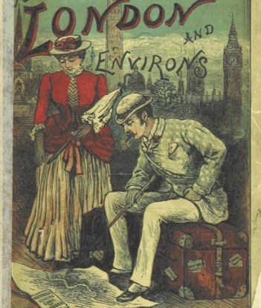
Content
British Library 19th Century Collection
More than 65,000 out of copyright editions from the 19th century, cover a similarly diverse range of topics philosophy, history, poetry and literature. The collection extends to over 25 million pages of previously rare and inaccessible content.
Notes:
The collection extends the end of the 19th century, thanks to the addition of the British Library 19th Century texts.
These relatively recently digitised versions of more than 65,000 out of copyright editions from the 19th century, cover a similarly diverse range of topics philosophy, history, poetry and literature. The collection extends to over 25 million pages of previously rare and inaccessible content, including the original typeface and illustrations for each title.
These texts have been digitised through a partnership between the British Library and Microsoft and each title has searchable full text versions of the digital page images.
There are page images and plain text available for all titles in this collection. The full text, as in ECCO, has been generated by way of OCR. Generally this is a bit better against the BL collection, but the usual caveats apply to its use.

Slide 7
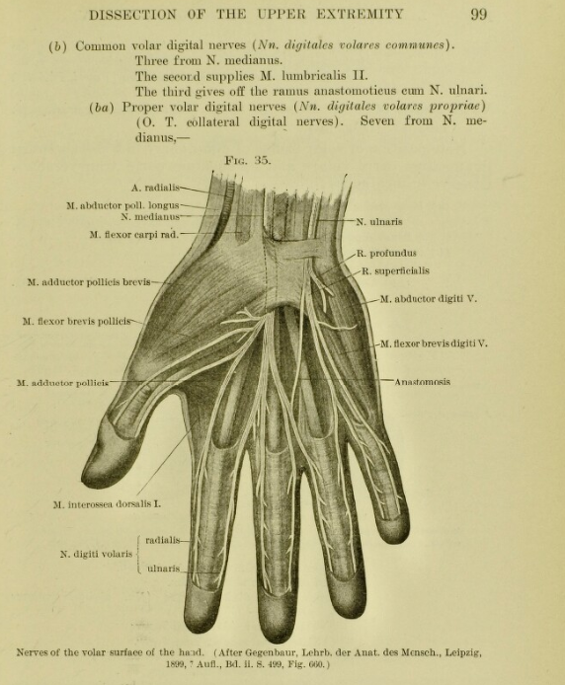
Content
UK Medical Heritage Library
The UK Medical Heritage Library (UKMHL) is the culmination of a three-year project between Jisc, the Internet Archive, the Wellcome Library and nine other partner institutions to digitise more than 20 million pages in over 70,000 works.
Notes:
Historical Texts has recently been extended as a result of the UK medical Heritage Library project. This is a three-year project funded by Jisc and Wellcome Library for the large-scale digitisation of more than 15 million pages, representing 66k texts, of 19th century published works. This is an OPEN COLLECTION AVAILABLE TO ALL and as such marks the first time the HT platform has included a collection on open access.
Main collection
The aim has been to create a comprehensive online resource for the history of medicine and related sciences, which significantly increases the availability of digitised text for teaching learning and research.
The UK Medical Heritage Library is drawn from university and other research libraries across the UK. The content covers a wide subject area that includes items about medical sciences, consumer health, sport and fitness, diet and nutrition and historical medical practices such as phrenology and hydrotherapy.
Each of the partners is listed on the portal homepage (URL to follow) and clicking on each provides a summary.

Slide 8
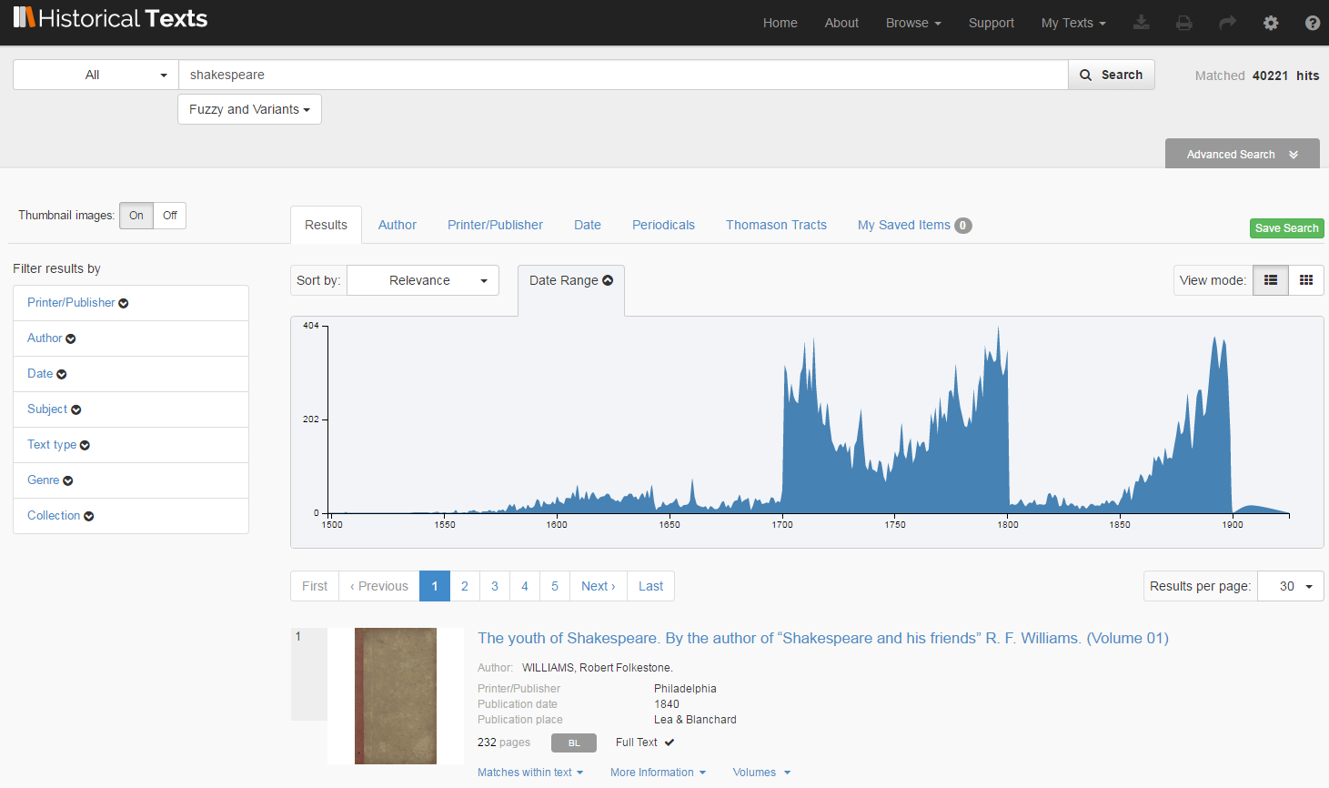
Features
Powerful search

Slide 9
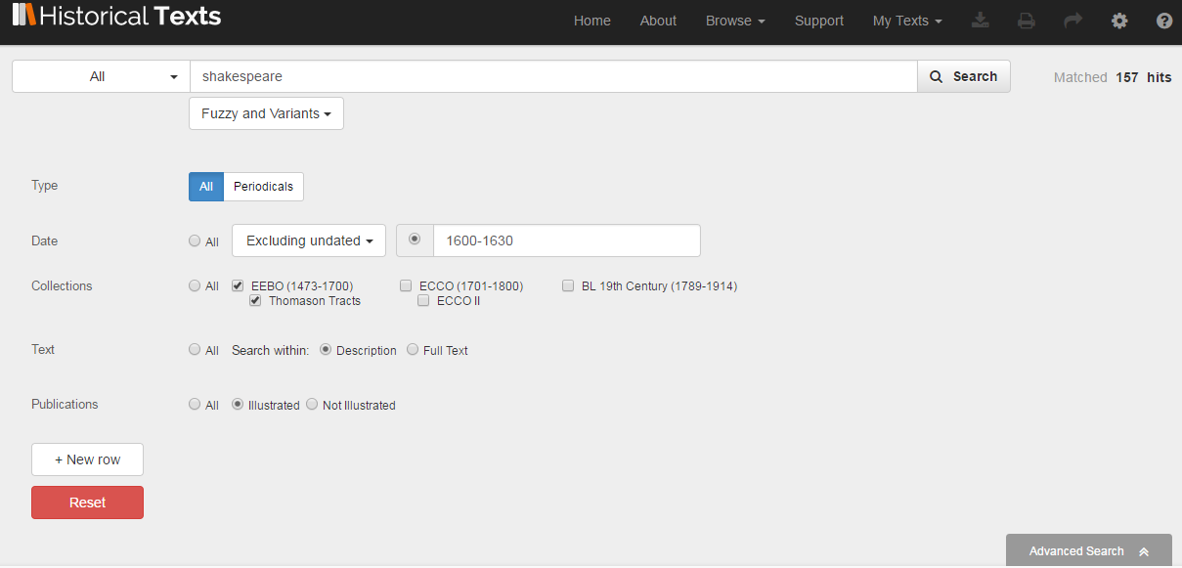
Features
With advanced options

Slide 10
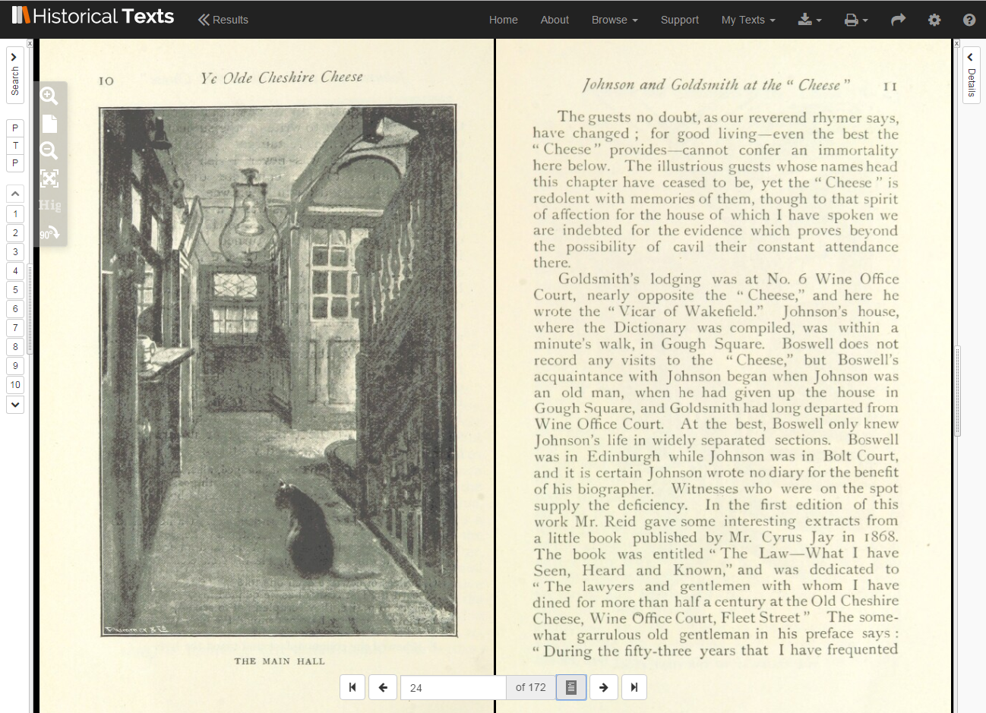
Features
Viewer

Slide 11
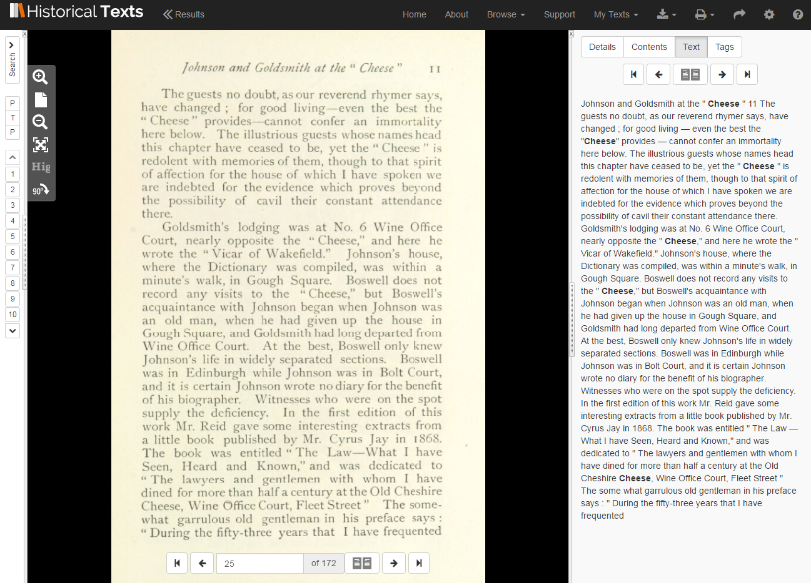
Features
Navigate the text and view metadata

Slide 12
Benefits
For learning and research
Collections spanning more than 400 years all in one place, making research easier, quicker and more comprehensive
Full text of many historical works, including rare and obscure works they might otherwise not know about
Reveals the form and appearance of original works, making research more rewarding, interesting and engaging
Eliminates the time and cost associated with visiting libraries that hold rare original works

Slide 13
Benefits
For teaching
Brings lectures and other presentations to life through the inclusion of original source material and illustrations
Powerful visualisations stimulate new ideas and approaches to historical datasets, whilst engaging visual learners
Provides access to rare materials, encouraging deeper exploration of a topic

Slide 14
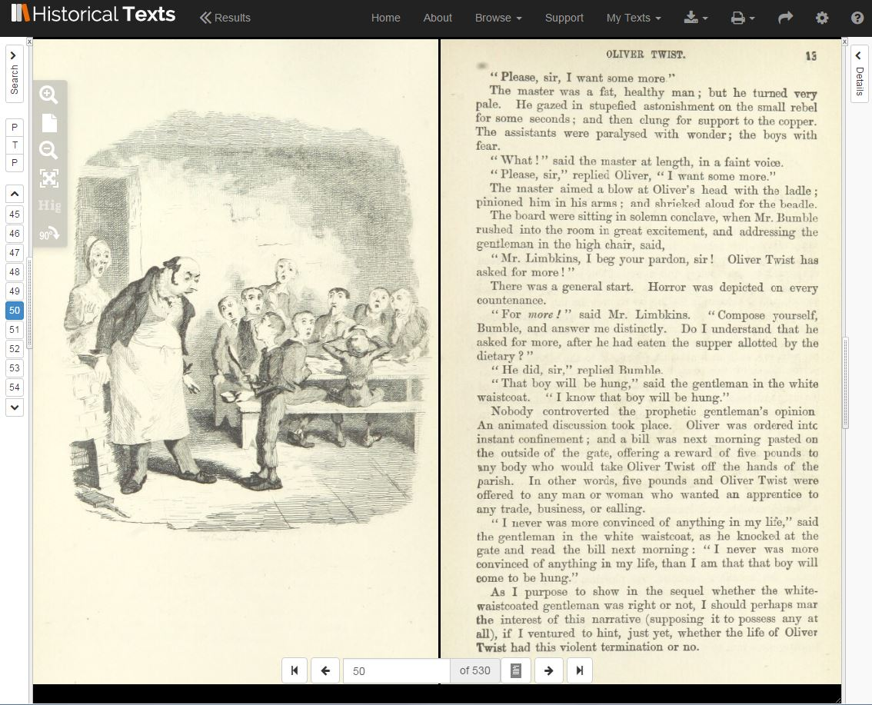

Slide 15
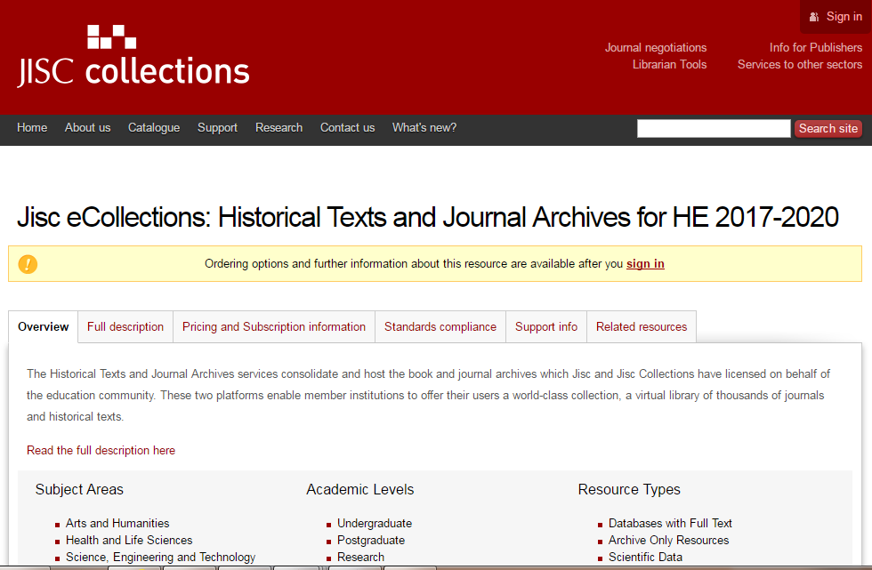
Subscribe
http://www.jisc-collections.ac.uk/Catalogue/FullDescription/index/2645
Historical Texts is available to UK HE and FE Institutions and Research Councils via subscription
Contact: help.digitalresources@jisc.ac.uk

Slide 16
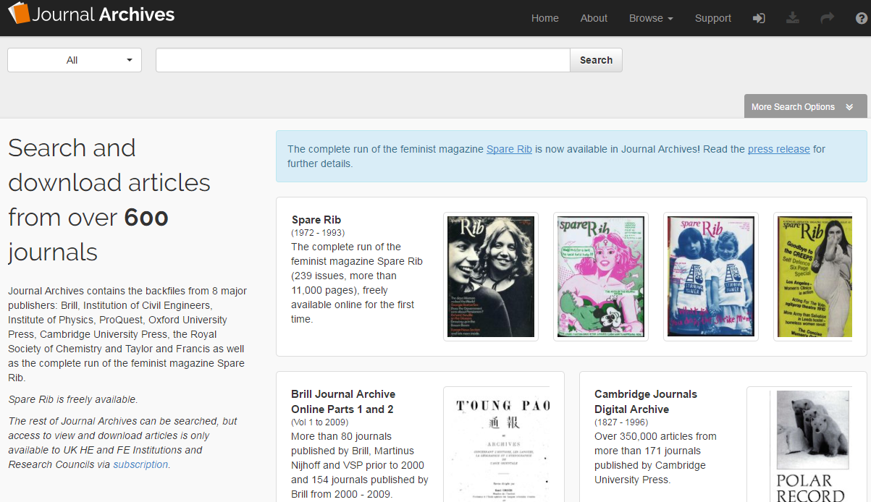
Subscribe
Journal Archives - https://journalarchives.jisc.ac.uk/
All subscribers will also have access to Jisc Journal Archives
Brings together diverse journal content to support teaching, learning and research
Includes the popular Spare Rib magazine

Slide 17
Jonathan Cates
Jonathan.cates@jisc.ac.uk
Product Manager (Historical Texts and Journal Archives)

